Slide 1
Computer Graphics
Quaternions
Fernando Geraci

Slide 2
Topics
Fernando Geraci
- Our tools so far
- Motivation
- What are Quaternions?
- Background
Complex Numbers as 2D vectors
Polar Coordinates in 2D Rotations
- Properties
Representation
Algebraic Operations
Conjugate
Norm and Normalization
Inverse
- Rotations
Implementation
Summary and alternatives
- Interpolation
How to
Potential Problems
Lerp vs Slerp
Polar Opposites

Slide 3
So far…
Fernando Geraci
We have been using the following mathematical objects:
Vectors
Magnitude, directions
Matrices
Transformations, Orientation
Euler angles
Conventional rotations
Now we will explore yet another object, called Quaternions.
y
x

Slide 4
Quaternions - Motivation
Fernando Geraci
At this point, we have seen that rotations DO NOT COMMUTE. The order on which we apply them, do matter.
Furthermore, know as well that Euler orientation angles are linked to one another in hierarchical order. Hence what would happen if:
Given a hierarchy of Y - X - Z (yaw, pitch, roll) we rotate the point (0,0,-1) :
What would happens should we rotate by 90 degrees first on the yaw (up direction) and then on the pitch (right direction) by the same amount?
Advantages:
- They solve a common problem with Euler-based rotations (yaw, pitch and roll)
- They do not rely on concepts such as frame of reference, handness and Euler hierarchy.
- They are really sweet to interpolate.

Slide 5

Quaternions - Definition
Fernando Geraci
These are a number system which extends complex numbers. Said representations, are easily interpolated due to the nature of how quaternions are produced.
Quaternions are represented and stored as 4 scalar (real) values. Note that i, j and k are 3 independent axes.
a + ib + jc + kd
Finally, one nice motivation for our topic of interest, is avoiding rotation problems such as Gimbal Locks
So in summary, we will use quaternions to represent orientation and to rotate vectors and interpolate said rotations.
This fella lost 1 degree of freedom!
(rotating on the aligned axis will produced a secondary undesired rotation)
Notes:
Imagine you have a point at (0,1,0), and after rotating said point along the x axis (roll) you end up at (1,0,0). Now, what would happen if you rotate

Slide 6
Background – Imaginary Numbers in 2D space
Fernando Geraci
We will look at imaginary numbers from a slightly, more geometrically inclined perspective, first recall i² = -1
This numbers, are represented as real number r multiplied by an imaginary component i, such that ri² = -r²
Let’s represent such a number with a the tuple (r,i), where r is the real number, and i is its imaginary component.
With this tuple definition, we can then express any real number as (r,0) = (5,0) = 5
Now, we must define some arithmetic properties of such tuples:
Addition: (u,j) + (i,k) = (u+i , j+k)
Multiplication: (u,j) (i,k) = (ui-jk , uk+ji)
It follows that if i = (0,1) then i² = (0,1) (0,1) = (-1,0) = -1 , so the property holds.
Finally, we will represent an imaginary number as a + bi = (a,0) + (b,0) (0,1) = (a,0) + (0,b) = (a , b) < a is scalar, b is imaginary
y’
a + ib = (a,b)
x y’ (imaginary axis) plane
x’
|a+ib| = sqrt(a²+b²)
NOTE: If the magnitude of said tuple is 1, we will call it a unit complex number just as if it was a real unit vector

Slide 7
Background – Imaginary Numbers in Polar Form
Fernando Geraci
Polar Representation of the complex number (a,b)
Let see how multiplying a complex number p₁ by another unity complex number p₂, produces a rotation of p₁
y’
Let r = |a + ib|
a = r cos(Θ)
b = r sin(Θ)
a + ib = r cos(Θ) + i r sin(Θ) = r (cos(Θ) + isin(Θ)) ← POLAR REPRESENTATION
Now let see what happens when we multiply two complex numbers expressed in polar coordinates.
a + ib = (a,b) = r (sin(Θ) + i cos(Θ))
b
|a+ib| = r
Θ
x’
a
y’
Given two real tuples p₁ and p₂ ,their product result in the rotation of p₁ by Θ degrees
p₁ * p₂ = r₁r₂ (cos Θ₁ cos Θ₂ – sin Θ₁ sin Θ₂ + i (cos Θ₁ sin Θ₂ + sin Θ₁ cos Θ₂))
If we use the known identities
sin (a + b) = sin a cos b + cos a sin b and cos (a + b) = cos a cos b – sin a sin b
= r₁r₂ ( cos(Θ₁ + Θ₂) + i sin (Θ₁ + Θ₂) ) then p3 = r₃ (cos(Θ₁+Θ₂) + i sin (Θ₁+Θ₂))
p3 = p1 * p₂
b
Θ₁+ Θ₂
p₂
p₁
Θ₂
Θ₁
x’

Slide 8
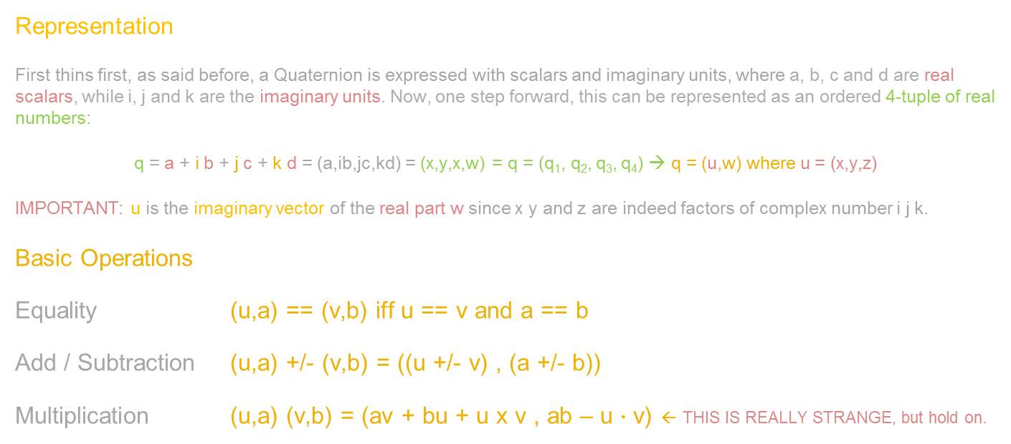
Quaternions – Algebraic Properties
Fernando Geraci
Representation
First thins first, as said before, a Quaternion is expressed with scalars and imaginary units, where a, b, c and d are real scalars, while i, j and k are the imaginary units. Now, one step forward, this can be represented as an ordered 4-tuple of real numbers:
q = a + i b + j c + k d = (a,ib,jc,kd) = (x,y,x,w) = q = (q₁, q₂, q₃, q₄) → q = (u,w) where u = (x,y,z)
IMPORTANT: u is the imaginary vector of the real part w since x y and z are indeed factors of complex number i j k.
Basic Operations
Equality (u,a) == (v,b) iff u == v and a == b
Add / Subtraction (u,a) +/- (v,b) = ((u +/- v) , (a +/- b))
Multiplication (u,a) (v,b) = (av + bu + u x v , ab – u $∙$ v) ← THIS IS REALLY STRANGE, but hold on.

Slide 9
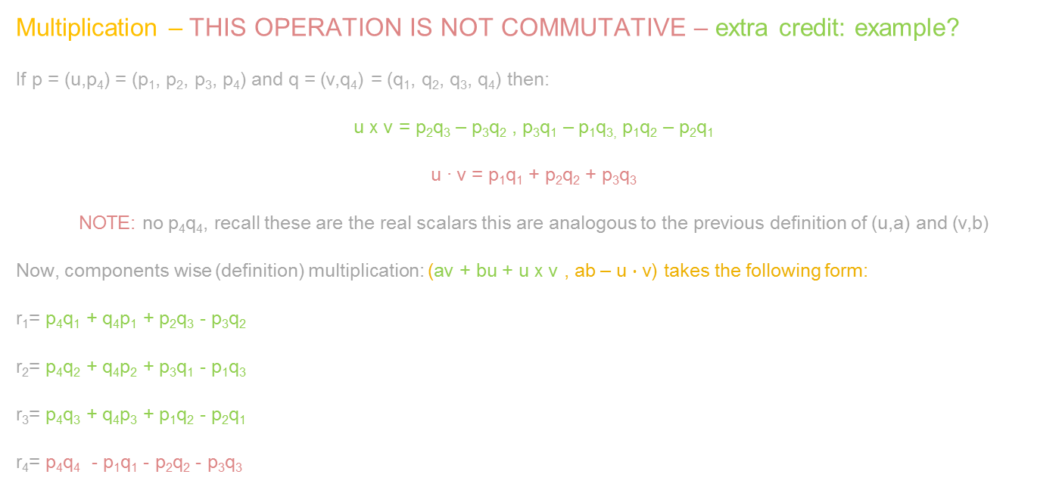
Quaternions – Algebraic Properties
Fernando Geraci
Multiplication – THIS OPERATION IS NOT COMMUTATIVE – extra credit: example?
If p = (u,p₄) = (p₁, p₂, p₃, p₄) and q = (v,q₄) = (q₁, q₂, q₃, q₄) then:
u x v = p₂q₃ – p₃q₂ , p₃q₁ – p₁q_{3,} p₁q₂ – p₂q₁
u ∙ v = p₁q₁ + p₂q₂ + p₃q₃
NOTE: no p₄q₄, recall these are the real scalars this are analogous to the previous definition of (u,a) and (v,b)
Now, components wise (definition) multiplication: (av + bu + u x v , ab – u $∙$ v) takes the following form:
r₁= p₄q₁ + q₄p₁ + p₂q₃ - p₃q₂
r₂= p₄q₂ + q₄p₂ + p₃q₁ - p₁q₃
r₃= p₄q₃ + q₄p₃ + p₁q₂ - p₂q₁
r₄= p₄q₄ - p₁q₁ - p₂q₂ - p₃q₃
p₄ -p₃ p₂ p₁
p₃ p₄ -p1 p₂
-p₂ p₁ p₄ p₃
-p₁ -p₂ -p₃ p₄
q₁
q₂
q₃
q₄
Q Multiply(Q p, Q q) { // p = (w + xi + yj + zk)
float w = p.w * q.w - p.x * q.x - p.y * q.y - p.z * q.z;
float x = p.w * q.x + p.x * q.w + p.y * q.z - p.z * q.y;
float y = p.w * q.y + p.y * q.w - p.x * q.z + p.z * q.x;
float z = p.w * q.z + p.z * q.w + p.x * q.y - p.y * q.x;
return new Quat (w,x,y,z).Normalize();
}

Slide 10
Quaternions – Algebraic Properties
Fernando Geraci
Conversions
Assume we have an scalar s and a vector v. We can represent this as Quaternions the following way:
scalar s = (0,0,0,s) and vector v = (v_{x}, v_{y}, v_{z}, 0)
If we apply the multiplication definition, we will find that for any real number s = (0,0,0,s), s * q, with q being a quternion, it IS indeed commutative:
(0,0,0,s) * ( q₁, q₂, q₃, q₄) = ( q₁, q₂, q₃, q₄) * (0,0,0,s)
Complex Conjugate
The complex conjugate of a complex number is its negative and is represented by q*
→ Same magnitud, same real and imaginary part, opposite sign.
In our Quaternion representation q = (q₁, q₂, q₃, q₄) = (-q₁, -q₂, -q₃, q₄) = (-u, q₄). Recall that q₄ is the real part of q.

Slide 11
Quaternions – Algebraic Properties
Fernando Geraci
Conjugate Properties
(p*)* = p
(p + q)* = p* + q*
(pq)* = q*p*
(sq)* = sq* for any real scalar s
(q + q*) = (u,q₄) + (-u,q₄) = 2q₄
qq* = q * q = ||u||² + q²₂
Norm Quaternion
This is given by ||q|| = ||qq*|| = SQRT(q₁² + q₂² + q₃² + q₄²) = SQRT( ||u||² + q₄² ) → if 1, it is a UNIT QUATERNION = Norm(0,0,0,1) = 1
Intuitively, we can see that:
||p*|| = ||p||
||pq|| = ||p|| ||q||
REAL NUMBERS
We use the Norm to normalize Quaternions (just as vectors),
which is the only way we can use them

Slide 12
Quaternions – Algebraic Properties
Fernando Geraci
Inverse
Given by: q⁻¹ = q* / || q || ²
(q⁻¹)⁻¹ = q
(qp)⁻¹ = p⁻¹ q⁻¹
If q is a unit quaternion then q⁻¹ = q *
Normalized Quaternion
Just as if it was a 4D vector, we divide its components by its Norm(q)

Slide 13
Quaternions – Rotations
Fernando Geraci
Let q be a unit quaternion q = (u,w) and p = (v,0) the vector we want to rotate.
Note that q has a real value w, while v has is a pure quaternion for its real part is 0.
We can achieve said transformation by simply multiplying qpq* → rot quaternion * vector * rot q conjugate.
…recall that q is UNIT so q* = q⁻¹. why are we multiplying by q⁻¹
Using the properties covered so far, we can appreciate that this operations yields to:
(u,w) (wv – v x u, v ∙ u )
That multiplication results in a vector, which real component is 0. That vector, is our product.
…the proof is lengthy and can be found in the support material section for you to review later.
Rotation Formula:
QuatRot_{n}(v) = cos(Θ)v + (1 – cos(2Θ)) (n ∙ v) n + sin(2Θ)(n x v) = cos (Θ/2) + (u_{x}i + u_{y}j + u_{z}k) sin (Θ/2) → q = (sin(Θ/2) n , cos(Θ/2))
In code, we would initialize the Quaternions components in the following way to achieve the desired rotation in the local axes:
Quaternion qx = new Quaternion(Mathf.Cos (Θ / 2), 0, 0, Mathf.Sin (Θ / 2)); // currOrient = Quaternion.Multiply(qx, currOrient)
Quaternion qy = new Quaternion(Mathf.Cos (Θ / 2), 0, Mathf.Sin (Θ / 2), 0); // currOrient = Quaternion.Multiply(qy, currOrient)
Quaternion qz = new Quaternion(Mathf.Cos (Θ / 2), Mathf.Sin (Θ / 2), 0,0); // currOrient = Quaternion.Multiply(qz, currOrient)

Slide 14
Quaternions – Rotations
Fernando Geraci
Summarizing:
1. The object we want to rotate has an orientation, stored as a quaternion (vector with no real value (v,0)).
2. The rotation we want to achieve, can we simply done by multiplying the orientation quaternion, by a rotation quaternion.
3. Just as Euler ones, rotations with quaternions (multiplying them) are NOT commutative.
4. If it is a vector we want to rotate (or point), we will multiply said vector by the rotation quaternion, and then by its inverse quaternion.
The code provided is basically how Unity implements its inner mechanics.
EXTRA CREDIT
1. Which other approach could be use to handle lock-free rotations without Quaternions?
2. How can we translate a quaternion to Euler Angles if needed?

Slide 15
Quaternions – Interpolation
Fernando Geraci
Algebraically speaking, we can see quaternions as 4 dimensional vectors.
We will use the math we have been using for 3-dimensional vectors, for this applies
We will deal with unit quaternions, which simplifies the need of radii (in this case, magnitudes)
The main goal is to interpolate the current orientation quaternion p with the product of its rotation p’
p’
Recall that the dot product of two vectors is p ∙ p’ = ||v|| ||u|| cos(Θ)
Because we are dealing with unit “vectors” this becomes p ∙ p’ = cos(Θ)
In straight forward manner, we do not want to linearly interpolate this orientations (Lerp) we want to Slerp them.
GOAL As in the picture, we want to find the unit quaternion q, which at time t will be p’ = c₁a + c₂b where c₁ and c₂ are constant weights.
(1-t) Θ
Θ
p

Slide 16
Quaternions – Interpolation
Fernando Geraci
To find the proper constants c₁ and c₂, we set up the equations the following way:
a ∙ p = c₁a ∙ a + c₂a ∙ b → cos(t Θ) = c₁ + c₂ cos (Θ)
p ∙ b = c₁a ∙ b + c₂b ∙ b → cos((1- t)Θ) = c₁ cos(Θ) + c₂
1 cos(Θ)
cos(Θ) 1
c₁
c₂
cos(tΘ)
cos((1-t) Θ)
=
Solving for the unknowns of Ax = b (LP problem) will yield the correct spherical interpolation formula.
p’
(1-t) Θ
Θ
slerp = (a,b,t) = (sin((1-t) Θ) a + sin(t Θ) b) / sin(Θ)
the angle between a and b (unit quaternions) is given by the
arccos(a ∙ b)
extra credit: do you recall why?
p

Slide 17
Quaternions – Interpolation
Fernando Geraci
Finally, here is its implementation, which is not much than spherically interpolate each component of the new created quaternion:
public static Quaternion Slerp(Quaternion p, Quaternion q, float t, float theta) {
// t must always belong to the [0,1] interval
t = Mathf.Clamp01(t);
float sinTheta = Mathf.Sin(theta);
float oMt = 1 - t;
return new Quaternion(
(Mathf.Sin(oMt * theta) * p.X + Mathf.Sin(t * theta) * q.X) / sinTheta,
(Mathf.Sin(oMt * theta) * p.X + Mathf.Sin(t * theta) * q.Y) / sinTheta,
(Mathf.Sin(oMt * theta) * p.Z + Mathf.Sin(t * theta) * q.Z) / sinTheta,
(Mathf.Sin(oMt * theta) * p.W + Mathf.Sin(t * theta) * q.W) / sinTheta);
}
extra credit: in which cases, spherical interpolation might cause:
a – computational problem, b – artifacts in animations.

Slide 18
Quaternions – Interpolation Lerp vs Slerp
Fernando Geraci
What happen if the angle is near 0 ?
This could result in a crash due to floating point approximations.
Solution: Lerp
What happen if we normalize Lerp instead of using Slerp directly?
HINT: Think of the rate of change.
extra credit: draw on board

Slide 19
Quaternions – Polar Opposites
Fernando Geraci
In short, given a quaternion p, we can achieve the same rotation angle by negating it –p with the difference that
p rotates on an angle of Θ
-p rotates on an angle of 2π – Θ
The polar opposite achieves the same orientation, but with a way bigger arc than the original. Always choose the shortest arc.
p’ → Θ
-p’ → 2π – Θ
This is given by:
||p + p’||² < ||p - p’||² → return –p’

